Slide 1
Linux device driver
Day 26 PPT
-SUBITHRA s

Slide 2
Kernel Space:
This is the most privileged level of the operating system. The kernel manages the system's resources and provides essential services to applications.
Kernel space has direct access to hardware and can execute privileged instructions. It handles tasks such as memory management, process scheduling, and device drivers.
Code running in the kernel space has unrestricted access to system resources and can perform critical operations.
User Space:
User space is where most applications and user-level processes run. These include everyday programs like web browsers, word processors, and media players.
User space applications run in a restricted environment and cannot directly access hardware or execute privileged instructions.
To interact with the kernel and access system resources, user space programs make system calls. These calls allow them to request services from the kernel, such as file operations, network communication, and memory allocation.

Slide 3
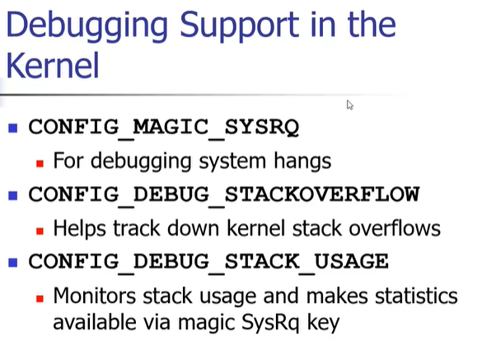

Slide 4


Slide 5


Slide 6
IOCTL
IOCTL (Input/Output Control) is a system call that allows user-space applications to communicate with device drivers and perform various control operations on devices. It's a mechanism for passing commands and data between user space and kernel space.
Definition in Header Files: Device drivers typically define a set of IOCTL commands along with their corresponding values in header files. These commands are often used to configure device settings, retrieve device information, or perform specific operations on the device.
User-Space Interaction: User-space applications can use the ioctl() system call to send commands and data to device drivers. The ioctl() function takes parameters such as a file descriptor representing the device, the IOCTL command, and optionally a pointer to data to be passed to the driver.
Kernel-Space Handling: When an ioctl() call is made from user space, the kernel routes the call to the appropriate device driver based on the file descriptor. The driver then interprets the IOCTL command and performs the necessary actions.
Switch Statement Handling: Inside the device driver's code, you'll often find a switch statement that handles different IOCTL commands. Each case in the switch corresponds to a specific command, and the driver executes the corresponding code block based on the command received.

Slide 7
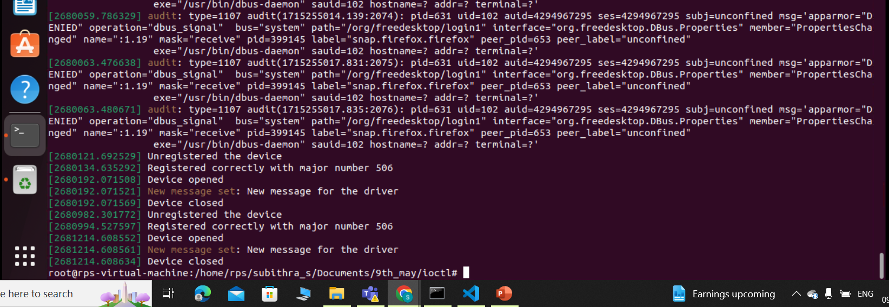
IOCTL

Slide 8
THANK YOU

